Slide 1
CSE 4208
FLAT INTERIOR DESIGN
Presented By,
Saimoon AL Farshi Oman
Roll: 1807018

Slide 2
Control Buttons
W => Camera Move Forward
A => Camera Move Left
S => Camera Move Backward
D => Camera Move Right
E => Camera Move Up
R => Camera Move Down
1 => Door Open
2 => Door Close
0 => Rotate Fan
C => Turn On Point Light
V => Turn Off Point Light
B => Turn On Directional Light
E => Turn Off Directional Light
M => Turn On Spot Light
P => Turn Off Spot Light
T => Look Up (Pitch)
F => Look Down (Pitch)
U => Look Right (Yaw)
H => Look Left (Yaw)
I => Right Raw
J => Left Raw
7 => Only Ambient Light
8 => Only Diffuse Light
K => Only Specular Light
L => Turn on All ambient,
diffuse and specular light

Slide 3
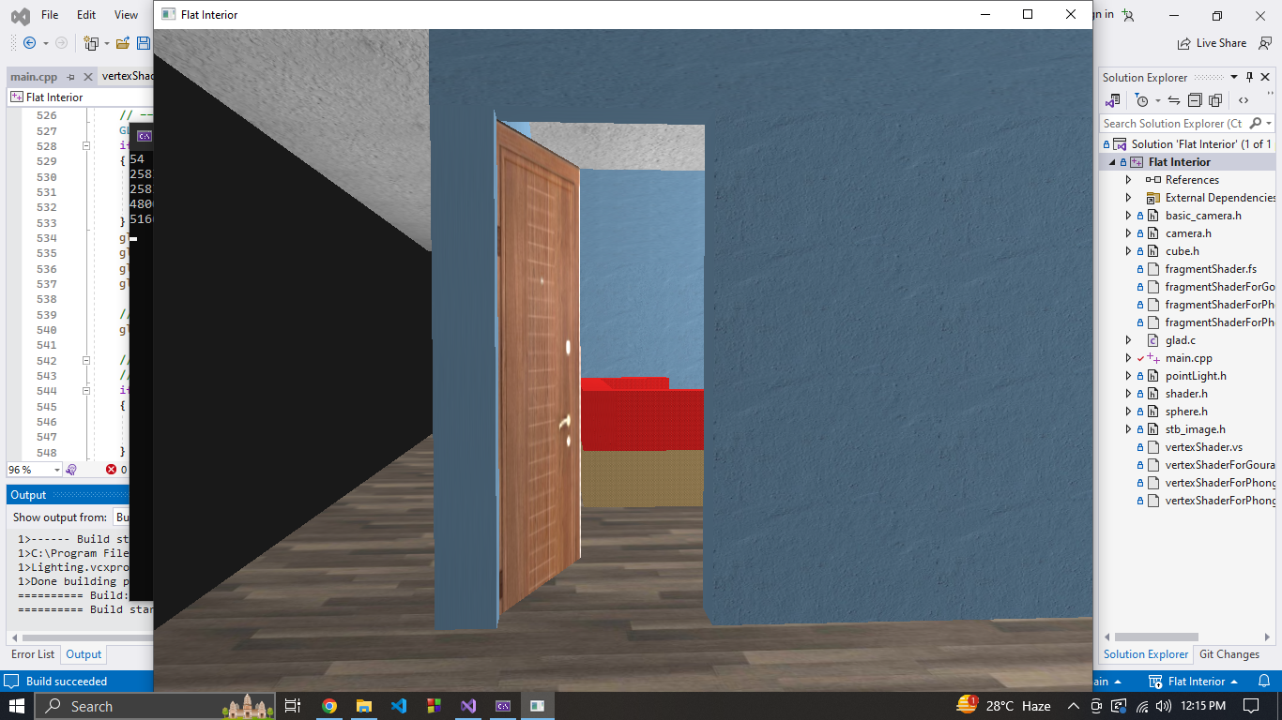
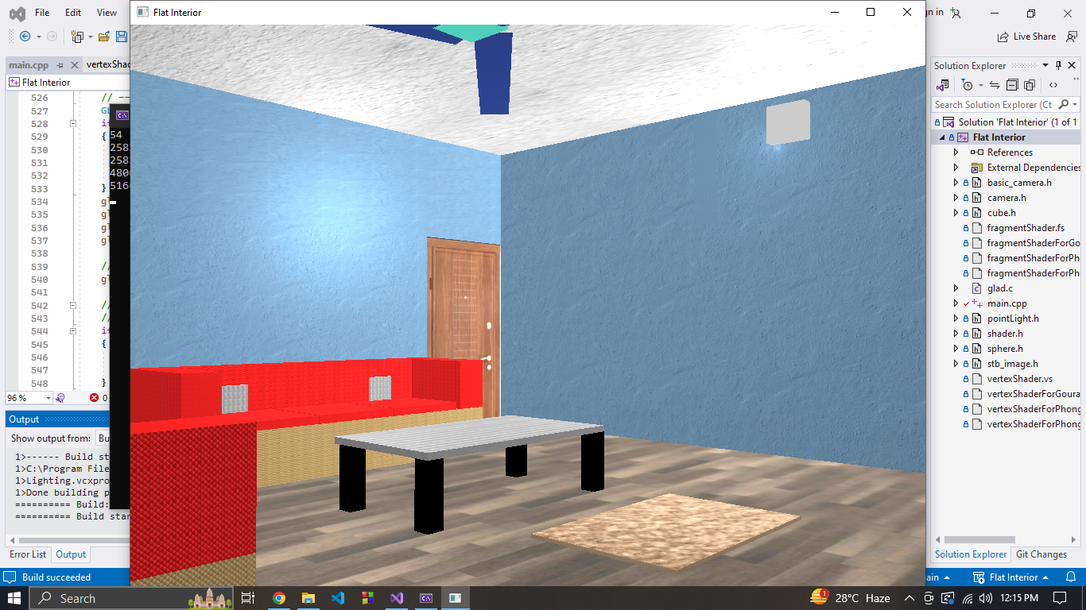
Drawing Room
Fig: Entrance
Fig: Drawing Room

Slide 4
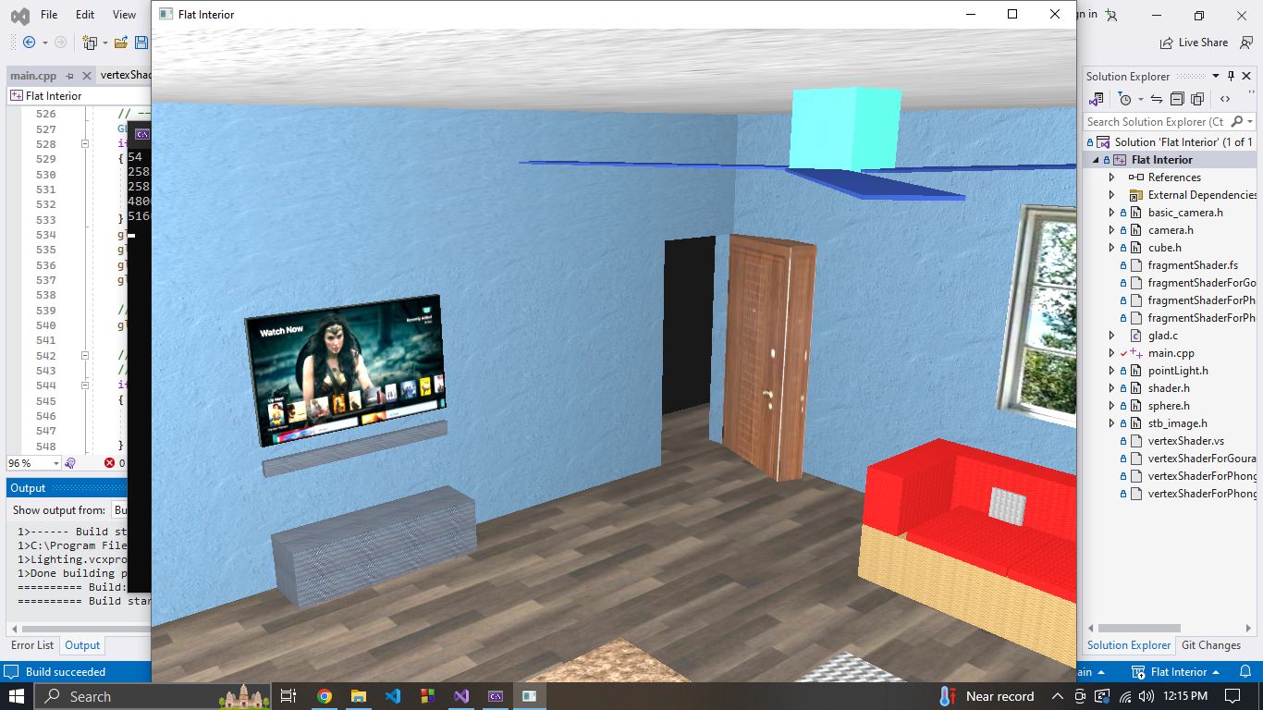
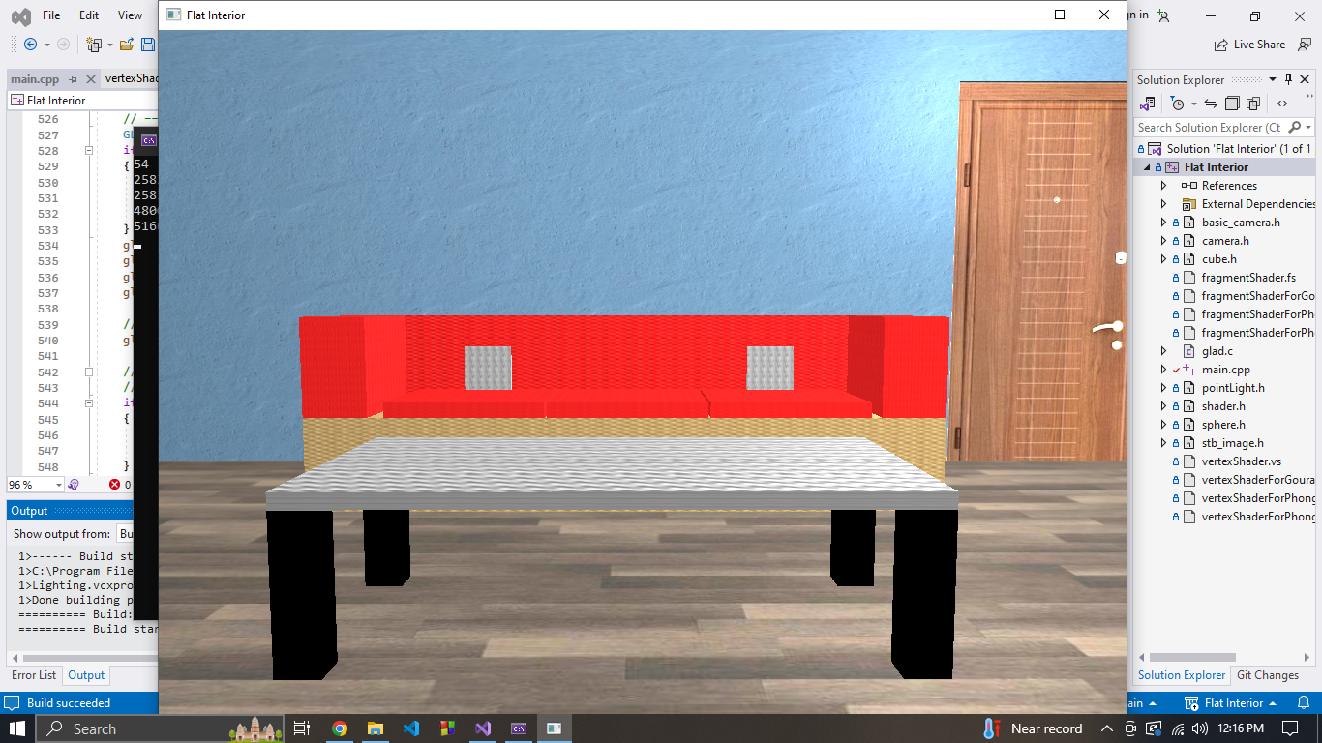
Drawing Room (Cont.)
Fig: Drawing Room
Fig: Sofa with table

Slide 5
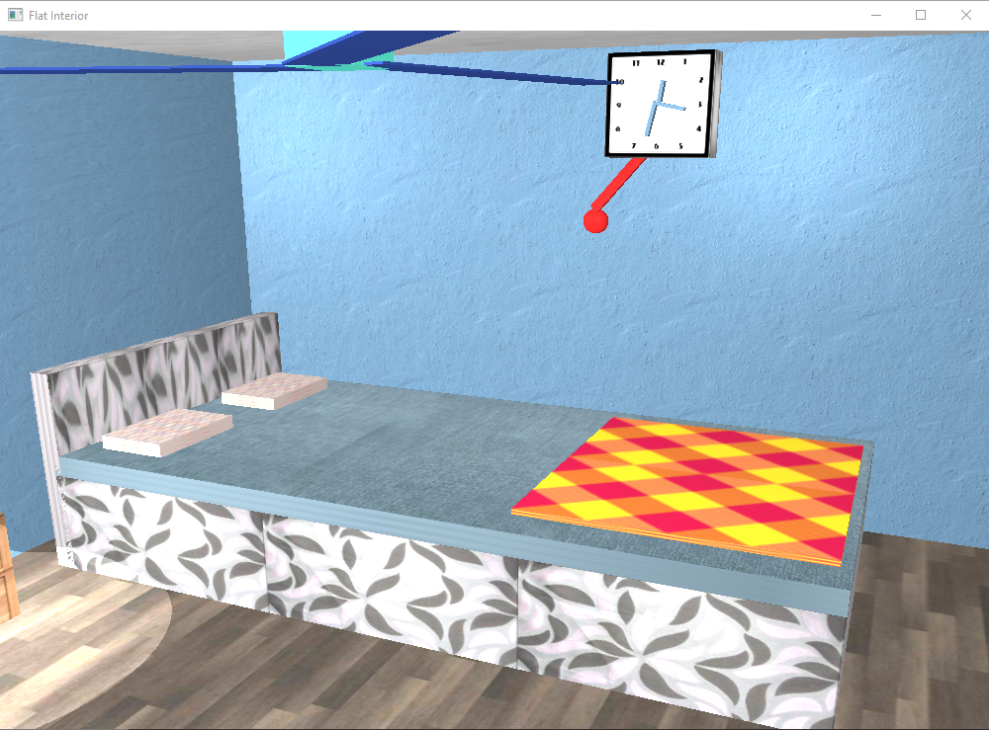
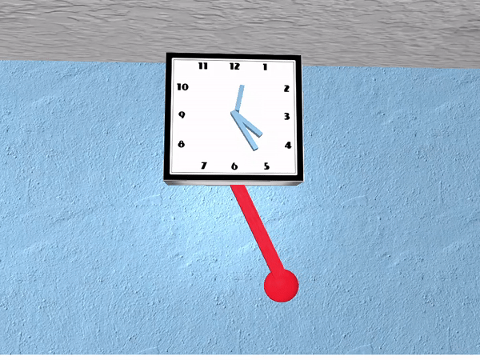
Bed Room
Fig: Bed Room
Fig: Real-time clock showing actual time

Slide 6
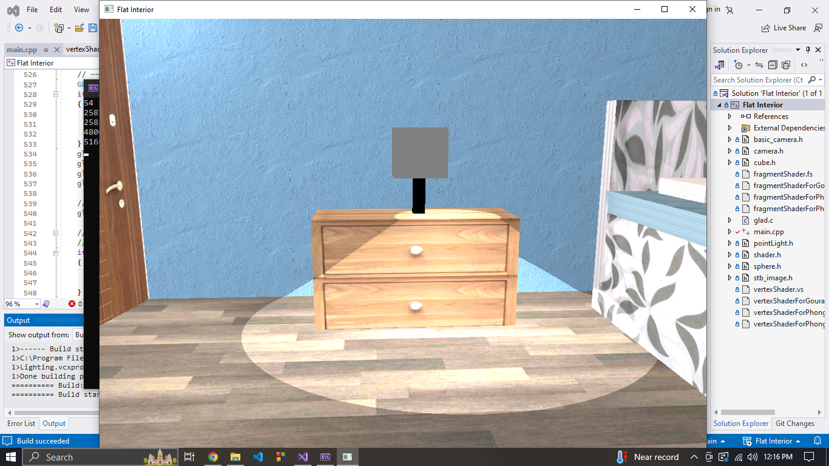
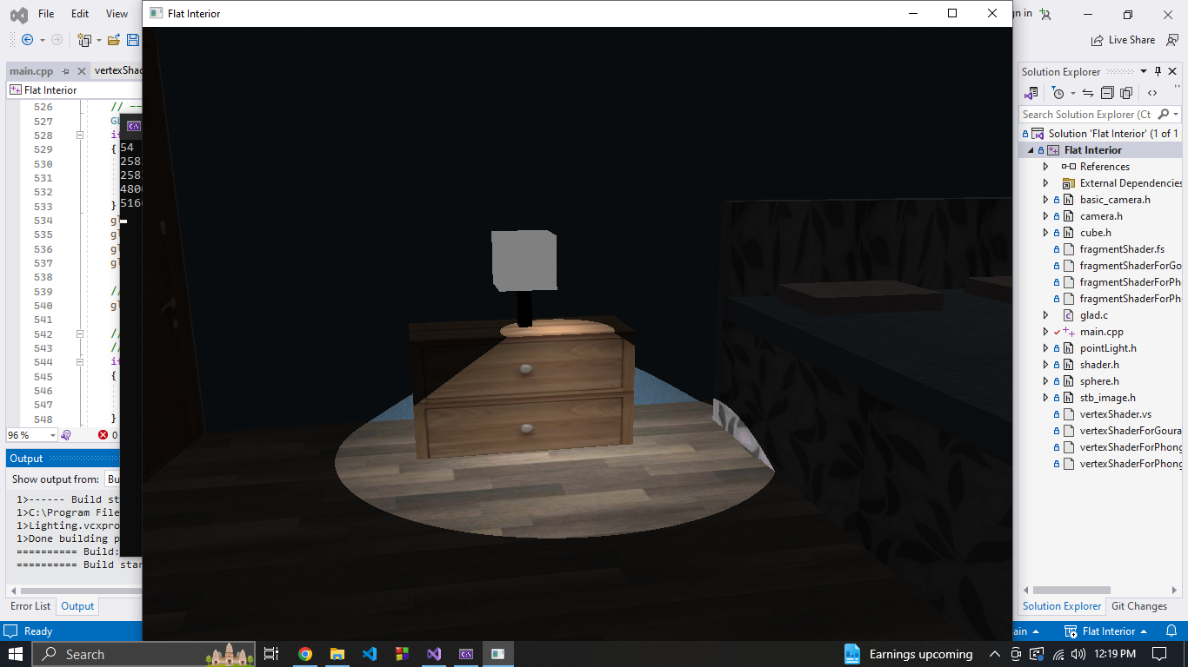
Bed Room (Cont.)
Fig: Lamp (Spot Light)
Fig: Only Lamp on

Slide 7
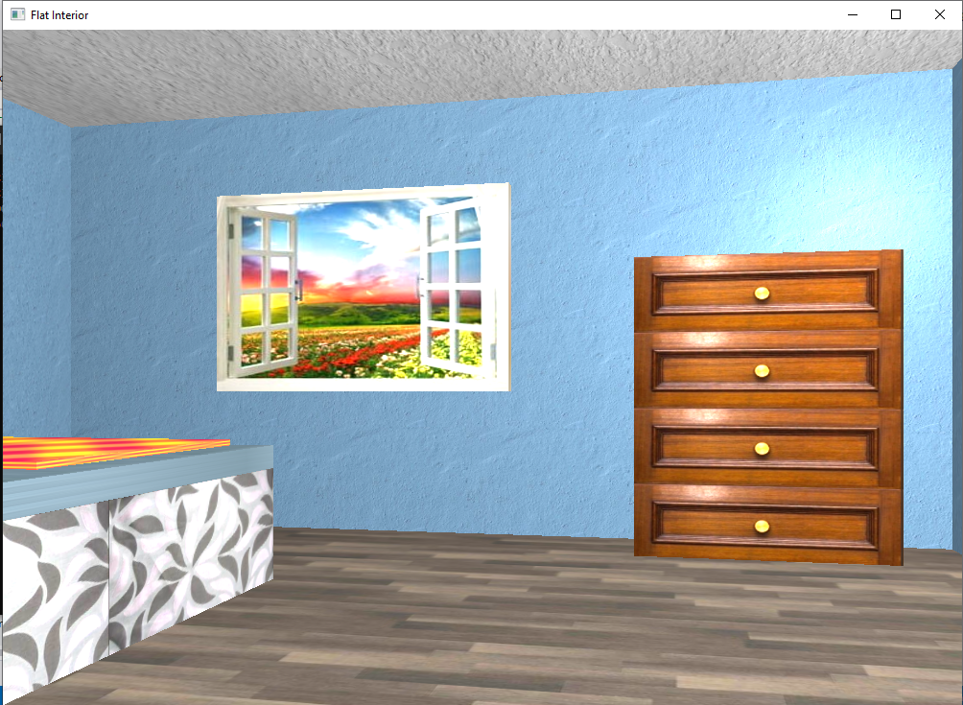
Bed Room (Cont.)
Fig: Bed Room

Slide 8
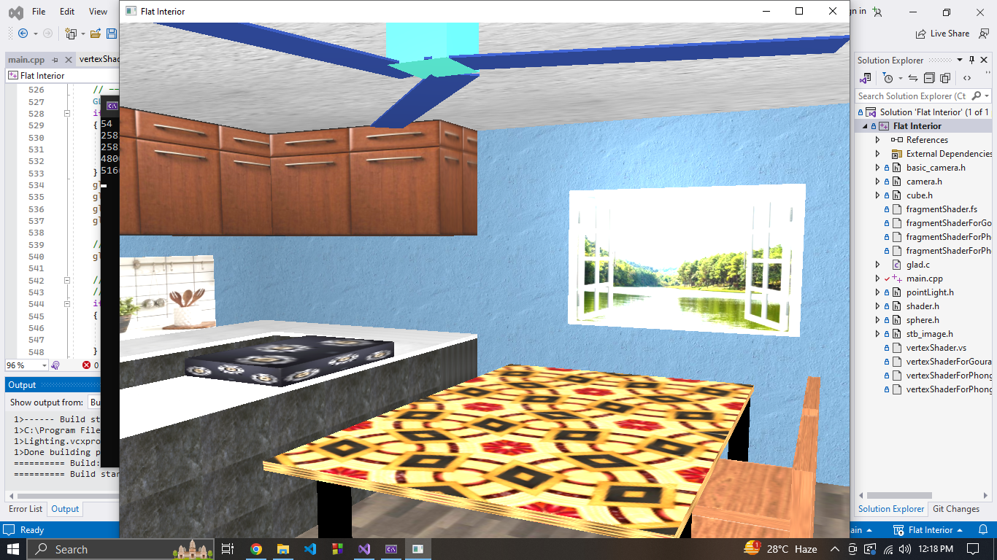
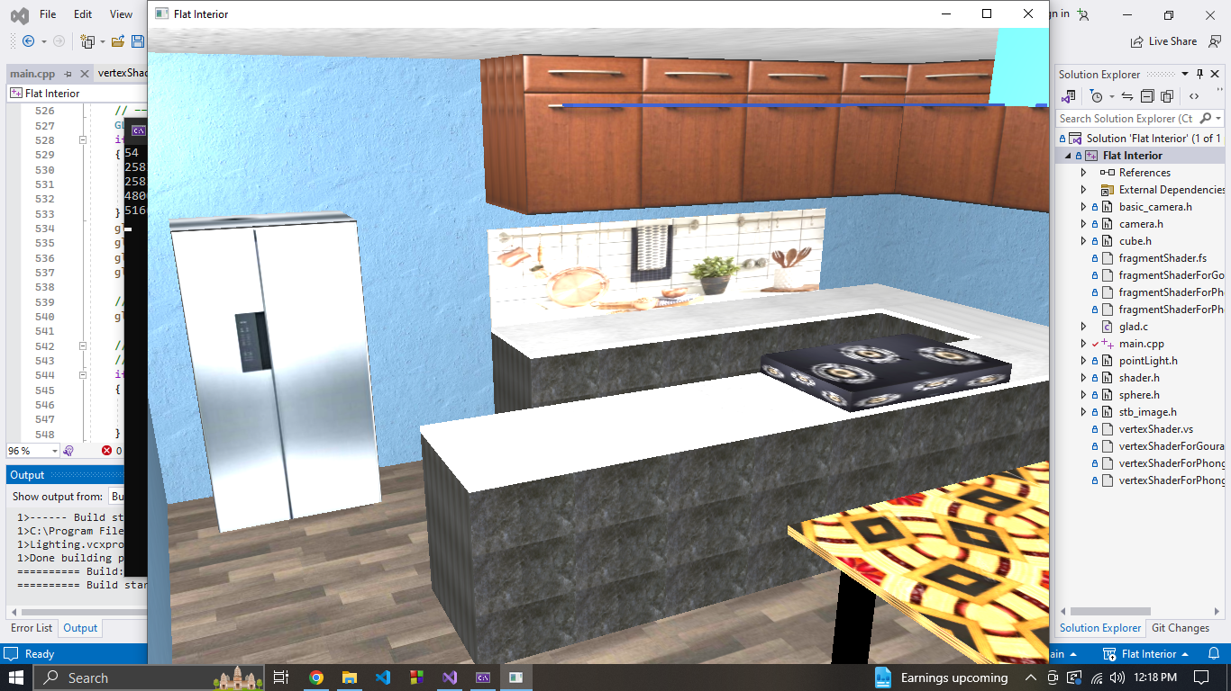
Dining & Kitchen
Fig: Dining
Fig: Kitchen

Slide 9
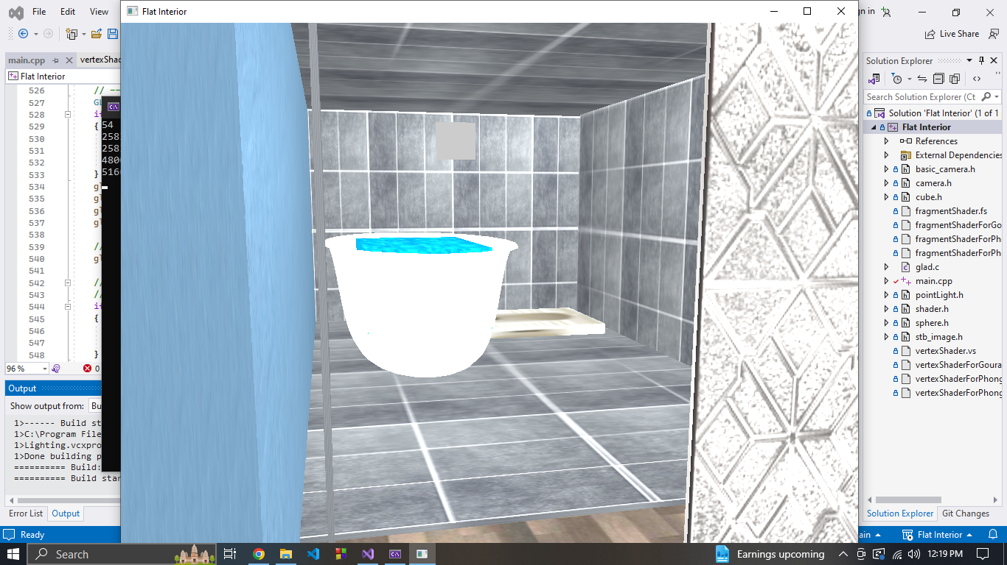
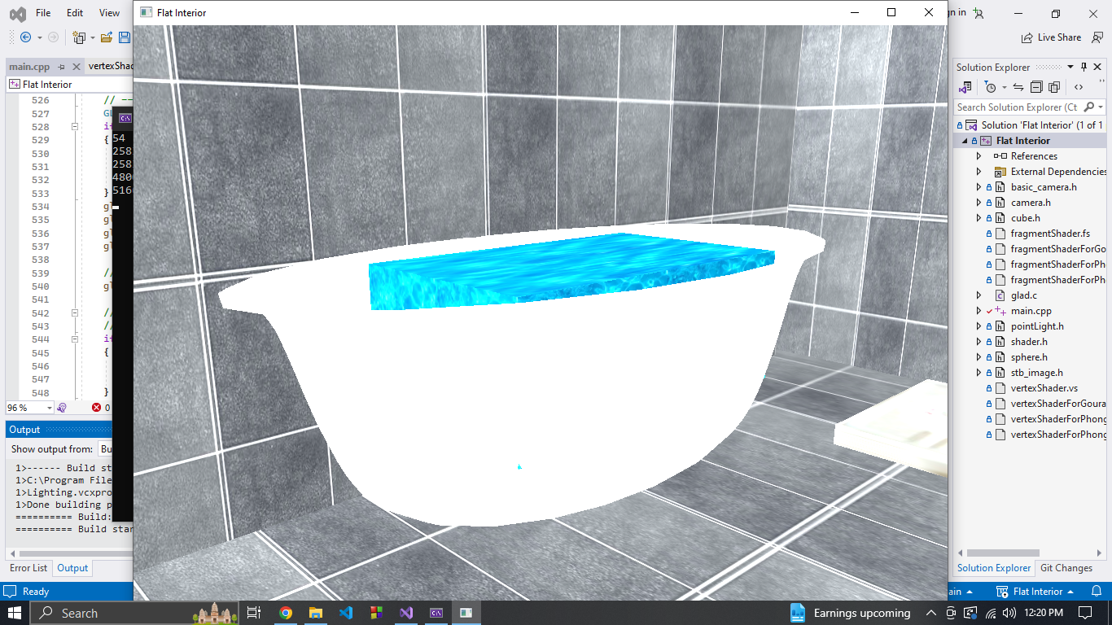
Wash-Room
Fig: Washroom
Fig: Bathtub (Bezier Curve)

Slide 10
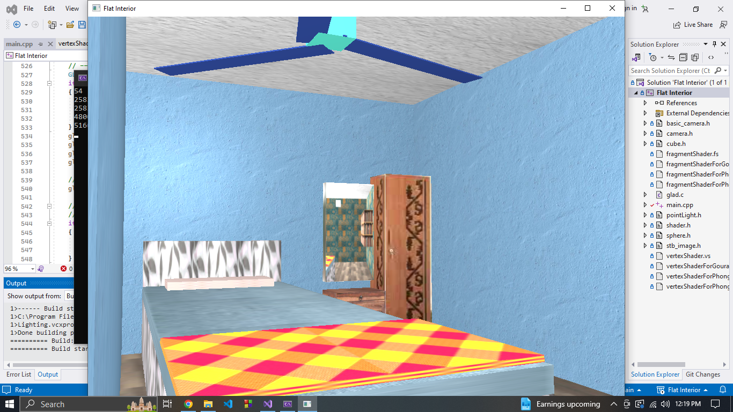
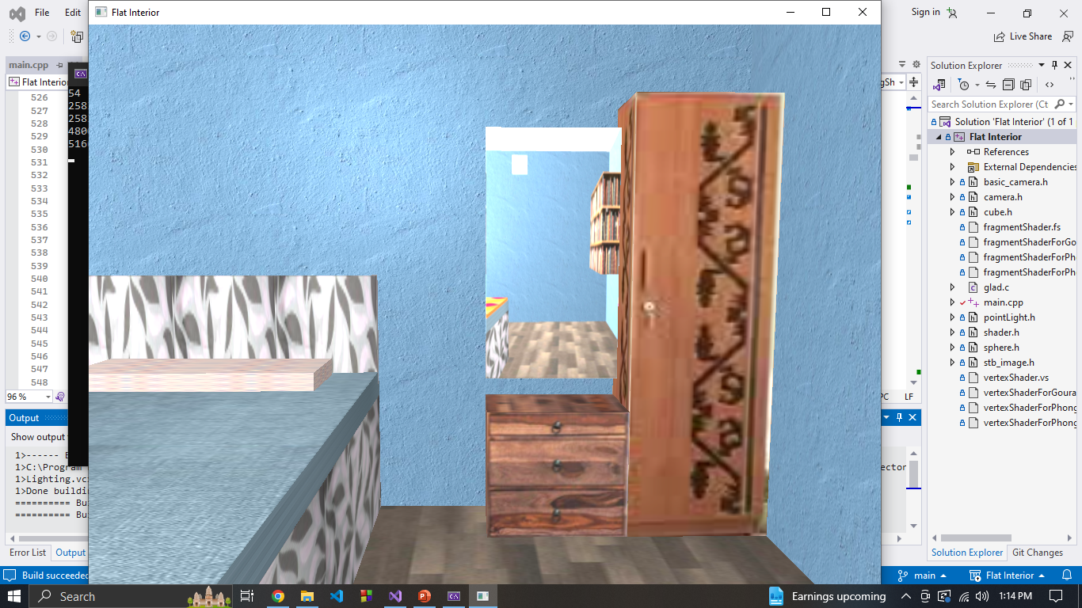
Bed Room
Fig: Bed Room
Fig: Dressing Table

Slide 11
THANK YOU

